Slide 1
Computer Code

Slide 2
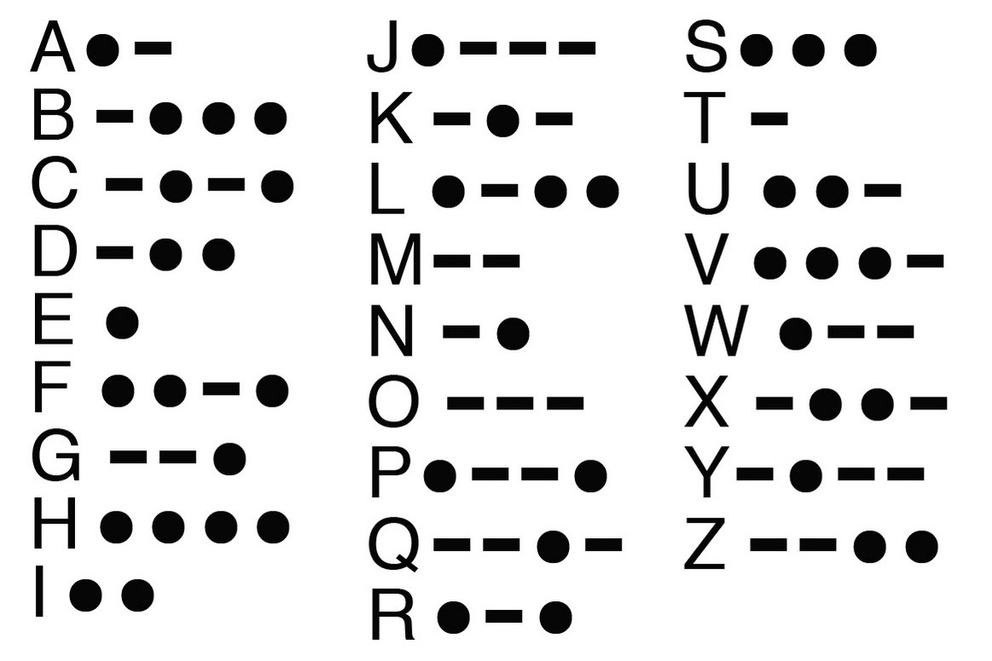
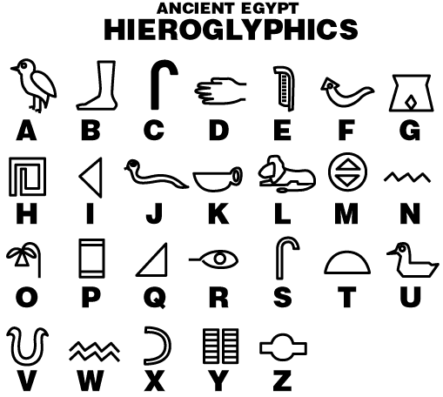
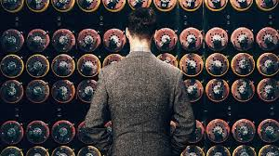
Use of Codes
The Imitation Game

Slide 3
What types of code do computers use?
https://commons.wikimedia.org/wiki/File:Evolution_of_computers.png

Slide 4
Source code is written using a human-readable programming language
Python
C++
R
Java
HTML
Perl
Ruby
Scratch
Ozoblockly

Slide 5
Just like English can be translated to Spanish…
Hi! How are you?
Hola! ¿Como estás?
Translation

Slide 6
…Source code is translated to machine code
If variable equals five:
Then print(“Hello World”)
0 1 1 0 1 0 1
1 0 1 1 0 0 1
0 0 0 1 1 1 0
Translation
Source code
Machine code
https://medium.com/basecs/a-deeper-inspection-into-compilation-and-interpretation-d98952ebc842

Slide 7
Machine code is also called binary code
A language made entirely of 0 and 1
Run by the central processing unit (CPU)
Binary is a system of numerical notation using only 0 and 1
Binary arithmetic uses base 2, we usually use base 10
0 1 1 0 1 0 1
1 0 1 1 0 0 1
0 0 0 1 1 1 0
Machine code

Slide 8


What is a bit?
1
TRUE
0
FALSE
Notes:
Computers read binary code because the 0 and 1 represnts on and off
A bit takes one of two values 0 or 1
Literally an electrical switch being turned on or off on the computer’s mother board
We can also think of it as true or false

Slide 9
Boolean: binary variable with two possible values
TRUE
FALSE
Notes:
Yes or No
One or Zero
Boolean values can be represented with binary notation

Slide 10
Statement | Binary notation | Boolean notation
The sky is blue
The Earth is flat
1
TRUE
0
FALSE

Slide 11
If you like the color pink:
Put your thumb up
Else:
Put your thumb down
Notes:
Think about the binary and boolean notation in these cases

Slide 12
If you like chocolate:
Put your thumb up
Else:
Put your thumb down

Slide 13
If you were born in Michigan:
Put your thumb up
Else:
Put your thumb down

Slide 14
If you like dogs:
Raise your right hand
Else if you like cats:
Raise your left hand
Else:
Keep your hands down
Notes:
If you like dogs AND cats you have to go to the left side of the room because liking dogs comes first--ORDER MATTERS

Slide 15
If you like to read:
Raise your right hand
Else if you like to watch tv:
Raise your left hand
Else:
Keep your hands down
Notes:
Notice the language I used when introducing your options

Slide 16
Conditional statement
If something is TRUE:
Then do something
Else if something is TRUE:
Then do something
Else:
Do something

Slide 17
Source code that programmers write
Machine code that a computer’s processor reads
If variable equals five:
Then print(“Hello World”)
0 1 1 0 1 0 1
1 0 1 1 0 0 1
0 0 0 1 1 1 0
Translation
Source code
Machine code
https://medium.com/basecs/a-deeper-inspection-into-compilation-and-interpretation-d98952ebc842
Notes:
Translation is done by a compiler or an interpreter

Slide 18
We write algorithms with source code
An algorithm is like a recipe
A process or set of instructions for the CPU to follow
https://www.webopedia.com/TERM/A/algorithm.html
Notes:
Give me an algorithm for doing a jumping jack

Slide 19
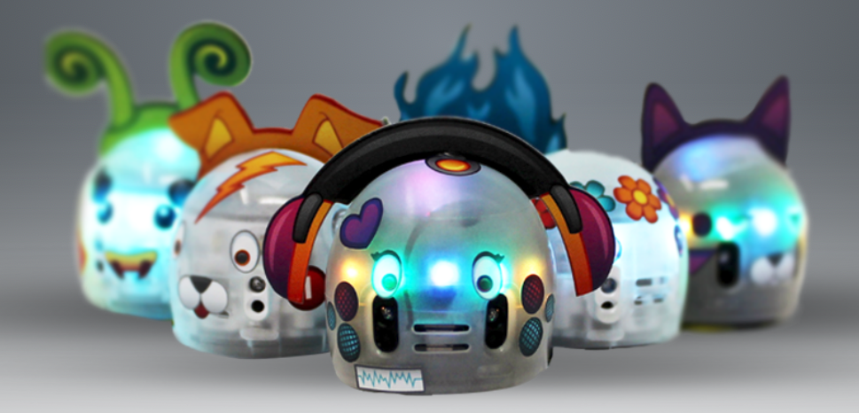
We write algorithms with source code to control Ozobot
Ozobot.com

Slide 20
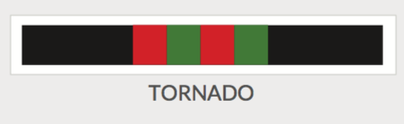
If sensor reads :
Spin around like a tornado
Else:
Continue moving forward on path

Slide 21
Goal: Turn your Ozobot into a Time Machine with booleans and conditional statements! Use source code to: 1. Move forward in time from present day to your bright future. 2. Help your future-selves avoid pitfalls along the way!

Slide 22
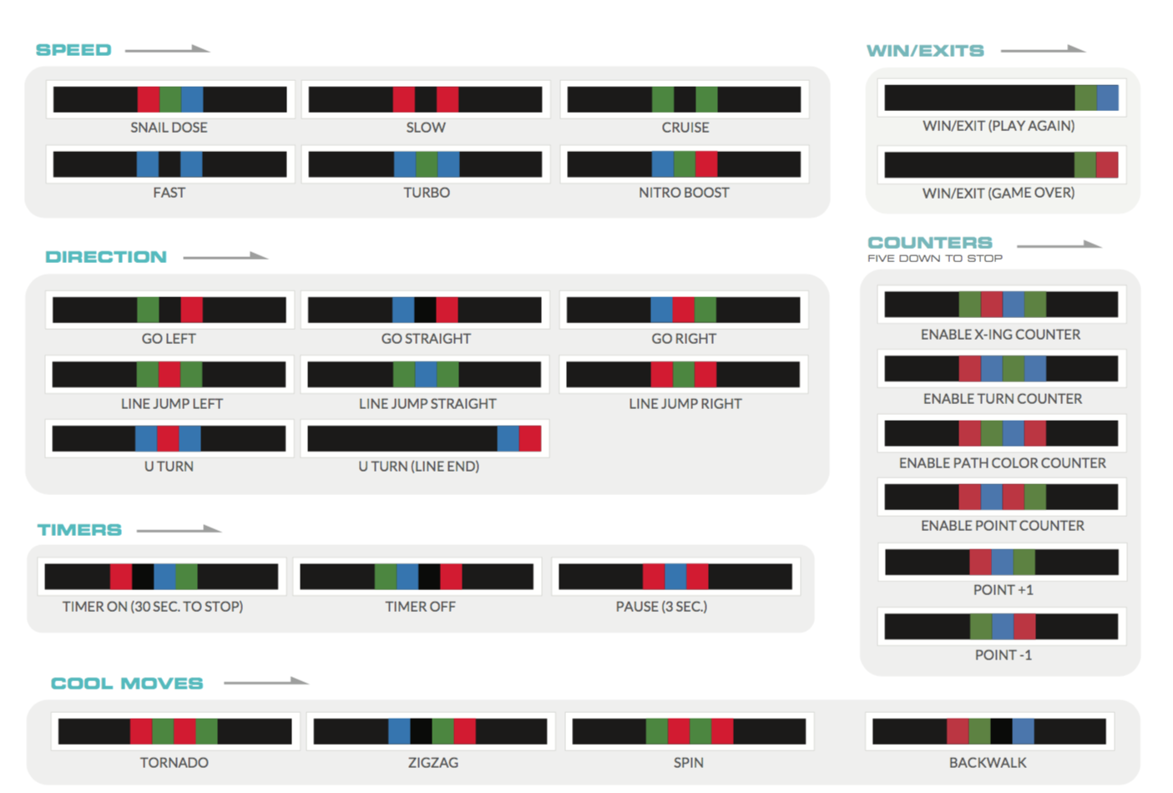
Ozocodes

Slide 23
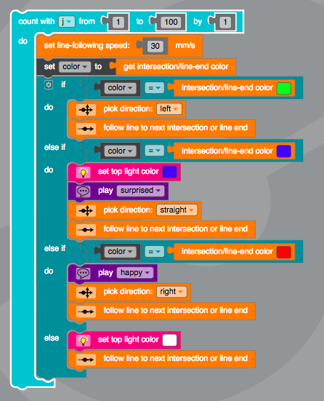

Slide 24

Visit https://girlswhocode.com/locations/
For high schoolers with transportation to University of Michigan:
Email gwc.bioinfo-requests@umich.edu for information about our Application for 2018-2019 Girls Who Code Club

Slide 25
Decimal: base 10 number system
2018 = 2(10³) + 0(10²) + 1(10¹) + 8(10⁰)
= 2(1000) + 0(100) + 1(10) + 8(1)
= 2000 + 0 + 10 + 8
= 2018
Binary: base 2 number system
11111100010 = 1(2¹⁰) + 1(2⁹) + 1(2⁸) + 1(2⁷) + 1(2⁶) +
1(2⁵) + 0(2⁴) + 0(2³) + 0(²) + 1(2¹) + 0(2⁰)
= 1024 + 512 + 256 + 128 + 64 + 32 + 0 + 0 + 0 + 2 +0
= 2018
Notes:
Bae 10 number system is the most common number system

Slide 26
Decimal Notation
Binary Notation
Translation
Value in Place 2 x 2² +
Value in Place 1 x 2¹ +
Value in Place 0 x 2⁰
3
0
1
1
Place 2
Place 1
Place 0

Slide 27
Binary Notation
Decimal Notation
Translation
0
0
0
0
0
0
1
1
0
1
0
2
0
1
1
3
0
1
1
4

Slide 28
What is a byte?
1
0
1
1
0
1
1
0
8 bits = 1 byte
Notes:
When you hear people say gigabyte or terabyte that is a unit of measurement based on bytes

Slide 29
What is a bit?
1
0
Notes:
A bit takes one of two values 0 or 1
Literally an electrical switch being turned on or off on the computer’s mother board
What is half a bit? A nibble

Slide 30
What is a byte?
One byte can store one typed character
Var = “a”
The variable Var uses 1 byte of storage
Var = “Wolverine”
How many bytes does Var use now?

Slide 31
Memory storage measurement system
1 bit
1 byte = 8 bits
1 kilobyte = 1024 bytes
1 megabyte = 1024 KB
1 gigabyte = 1024 MB
1 terabyte = 1024 GB
Notes:
1.44 MB floppy
4.7 GB DVD
1 TB Hard drive

